Slide 1
Welcome to NC CRRC
Incident Response

Slide 2
This Morning’s Plan
Talk about who we are
What will we do in this workshop
Breakout labs
Eat lunch

Slide 3
Who are Kyle & Cody

Slide 4
What we’ll cover: Session I
We’re all birds of a different feather
High level overview of what these tools are
Network taps
Protocol analysis (wireshark)
Summarize data (bro/zeek)
Alerting on bad stuff (snort/suricata)
Methods of capturing network traffic
What does our data look like: NSM centric
Deeper dive into wireshark
File extraction
Scavenger hunt

Slide 5
Session II

Slide 6
Session III

Slide 7
Session IV: TLS Inspection
For those with more money than time
Dip into commercial firewall applications
Palo Alto
It’s ok: academics can get it for free
Application ID
Issues in capturing traffic: encryption
Methods of solving: encryption

Slide 8
Session V: Wireless
We hype packet level analysis
But we often forget… wifi
Key pieces of 802.11: management frames
Normal stuff: associations & disassociations
What trashy things do people do on 802.11?
How we can detect/monitor for this

Slide 9
Session VI
The last session!
Network monitoring scavenger hunt

Slide 10
Getting Traffic
Just use a hub
Port mirroring/SPAN port
Network TAP

Slide 11
Using Hubs
Just kidding…

Slide 12
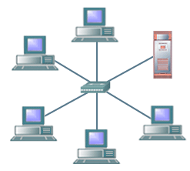
SPAN Ports
Mirror all traffic from a switch to a device
Device can be:
An analysis/capture device
A VLAN
A virtual machine
Can drop traffic if oversubscribed
“The switch treats SPAN data with a lower priority than regular port-to-port data” - Cisco

Slide 13
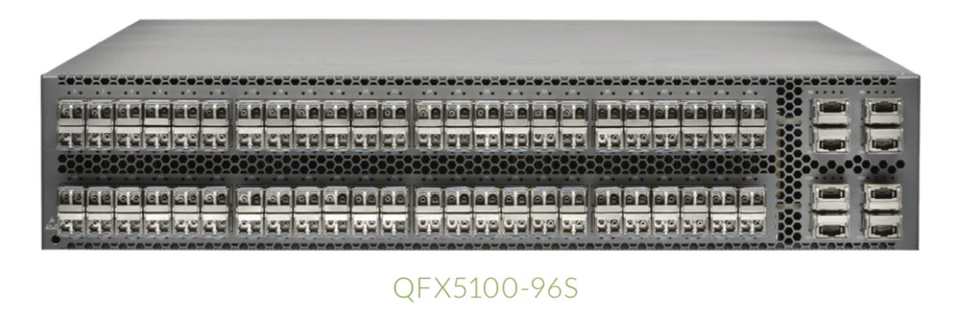
Oversubscription

Slide 14
Network TAP
TAP: Test Access Point
Can be active or passive
Meets extra legal requirements sometimes*
Isn’t hindered with oversubscriptions

Slide 15
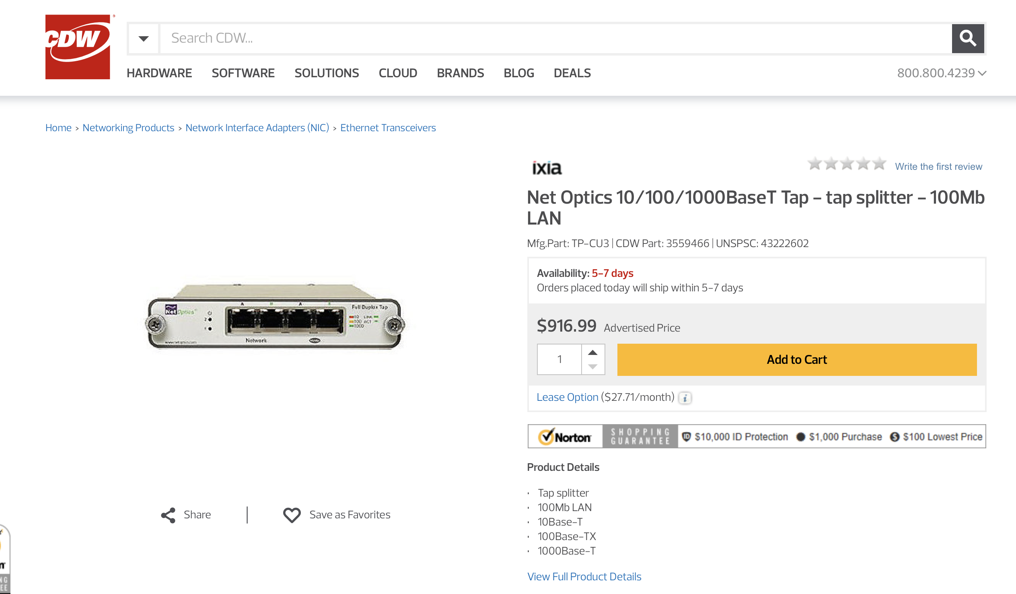

Slide 16
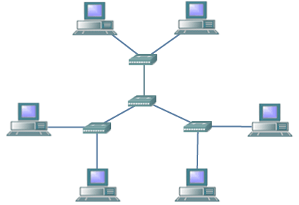
Challenges

Slide 17
Types of Data in NSM

